Slide 1
Voluntary Benefit Program Offering Exclusively for Independent Contractors
Company ABC Presented by | Your Name(s)
Presented by | Cottingham & Butler
Wes Digmann, Vice President, Sales Executive Transportation Division
Andrea Graves, Benefits Consultant

Slide 2
Voluntary Benefits for Independent Contractors
Why Offer Voluntary Benefits to Independent Contractors, Owner Operators and/or Lease Purchase Drivers?
Recruiting & Retention
Competition: Most mid-size and large contractor fleets offer a program
Contractor Shortage: Perks help to attract and preserve drivers
No Cost to Carrier: With the right program, there is virtually no effort or administrative work or cost for a carrier to offer benefits to contractors
Peace of Mind for Your Contractors: Health related events are the 3rd leading cause of contractors going out of business*
Give them access to group discounted insurance products and benefits they can’t get or afford on their own on a stand-alone basis
ACA (Obamacare) Taxes may apply to individuals not enrolled in a qualified medical plan – contractors must now either find coverage or pay a tax
*According to American Truck Business Services survey

Slide 3
Voluntary Benefits for Independent Contractors
What Benefits Can Be Made Available to Contractors?
Major Medical Plans
Individually Underwritten Plans
ACA Exchange/Marketplace Options
Health Indemnity Plans
Dental Insurance
Vision Insurance
Life Insurance
Disability Income Protection
Accident Insurance
Critical Illness Insurance
Cancer Insurance
CDL Defender - Pre-paid Legal Services

Slide 4
Voluntary Benefits for Independent Contractors
How Do These Programs Work?
Association Model – Contractors join an Association which then gives them to access benefits at group discounted rates. This creates a protective wall between the motor carrier and the 1099 driver.
No employee/employer language
No contributions from motor carrier and no cost to offer
Enrollment handled by licensed enrollers (not motor carrier) via call center with recorded calls and/or on-site terminal visits
Premiums collected via settlement deduction Weekly settlement deductions are started 1 month prior to effective date of coverage… to ensure a full month of premiums/fees are collected in advance of coverage starting . Avoids risk of cost or bill reconciliation for the motor carrier if a driver leaves or goes negative. UTBA will contact the driver if they get behind on payment.

Slide 5
Voluntary Benefits for Independent Contractors
Selecting the Right Association Program:
Solid Benefit Package - Best rates, coverage and guarantee issue provisions
Full Service Enrollment Team - Licensed experienced enrollers, adequately staffed, multi-lingual, makes outbound calls and offers on-site meetings
Simplified Administration and Flexible Billing - Should require very little administrative work for motor carrier with online systems/tracking available
Perpetual Enrollment Focus - Most enrollment firms focus on initial roll-out with no ongoing outreach or support for new contractors causing program to diminish over time - select a partner that is proactive all year long
Portability - Contractors can keep benefits if lease or contract terminates

Slide 6
Cottingham & Butler/UTBA Partnership
UTBA (Universal Trucking Benefits Association) has been in business for over 30 years working exclusively with 1099 drivers. UTBA works with hundreds of motor carriers nationally, providing affordable group level benefits and best-in-class service to their independent contractors and lease purchase drivers.
Advantages of the Cottingham & Butler/UTBA Contractor Program:
Best overall full package of benefits at group discounted rates
Guarantee issue products with higher benefit limits than most
Exclusive high benefit limited medical plan with critical illness rider
Best overall dental and disability plans available in the marketplace
Dedicated C&B Call Center – licensed full-time live enrollers who work exclusively with drivers (Spanish and English Speaking) *** Will also provide on-site enrollment options at terminals***

Slide 7
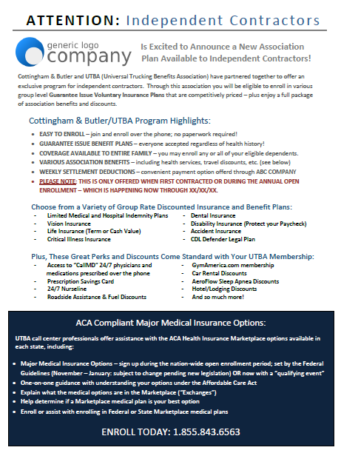
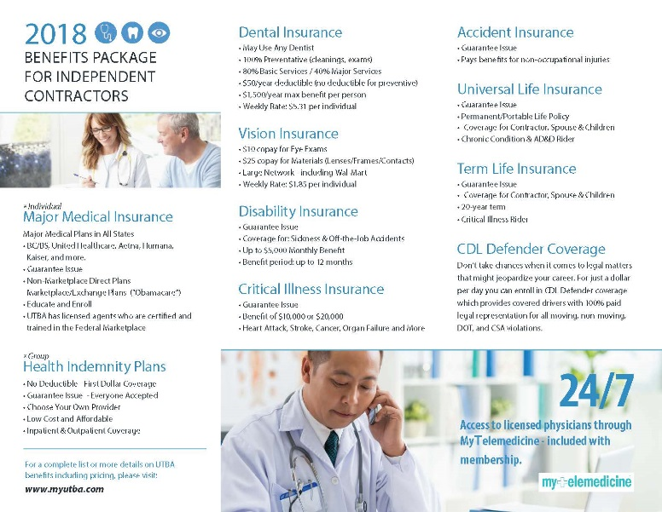
Marketing and Enrollment Materials
Books, brochures and any other materials you wish to use can be customized with your truck photos, logos, etc. if desired
Electronic versions of all materials available for posting online or emailing
Videos are also available for you link to online or show at orientation
www.myutba.com

Slide 8
Marketing and Enrollment Materials
All materials… books, brochures, memos and letters will be printed and mailed or distributed to your contractors with NO COST to the motor carrier.
All certificates, contracts, communication materials, documents, etc. have been thoroughly analyzed and approved by the most respected and widely used legal firm in the country to ensure no risk or liability for the motor carrier related to potential employee/employer relationship implications due to offering a “benefit program”. The association and approved contracts, products and set up provides clear delineation and protection for the motor carrier even when offering payment options through settlement deduction.
Call center enrollment (paperless – recorded calls – no applications required for group products). Major medical must be purchased separately. Our UTBA enrollment team will make outbound calls and can also be available at terminals for in-person meetings with the contractors if you prefer that.
Exclusive administration system integration available through CBA with all contractor insurance products offered through the motor carrier (ease of administration not available through other program offerings) – makes it easy to track, run reports and reconcile billing (if necessary) in one system.

Slide 9
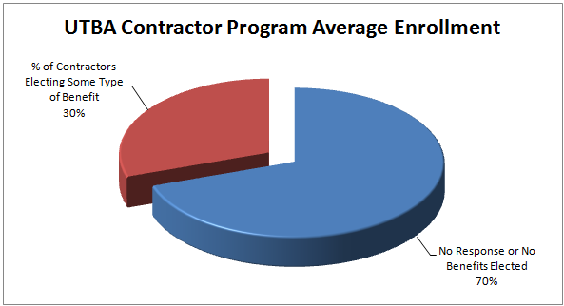
C&B/UTBA Enrollment Statistics
UTBA Enrollment Percentage
Average is twice as high as other associations… Why?
- Tenured Enrollers
- Better Benefits and Rates
- Understand Unique Driver Needs
Most Popular Products Purchased by Drivers:
Disability Income Protection
Dental Insurance
Life Insurance
Vision Insurance

Slide 10
Implementing the C&B/UTBA Program
Next Steps…
Decide if offering a contractor program makes sense
Review package of offerings through C&B/UTBA
Determine which benefits to include in package
Establish a timeline for initial roll-out and annual enrollment period
Approve communication method, announcement and materials to be used
Provide a list of current 1099 drivers/contractors and their contact info
C&B/UTBA takes care of customizing, printing/mailing, calling, communicating and coordination with the drivers as the program is rolled out
C&B/UTBA provides detail to motor for settlement deductions on an ongoing basis and handles all service related to the program

Slide 11
Andrea Graves, Benefits Consultant
Email: agraves@cottinghambutler.com
Cell Phone: (312) 802-8824

