Slide 1

Updated Transportation Trends
Todd C. Fowler
Managing Director
Transportation & Logistics Equity Research
KeyBanc Capital Markets Inc.
July 2018
KeyBanc Capital Markets Inc., Member NYSE/FINRA/SIPC
Important disclosures for the companies mentioned in this report can be found at
https://key2.bluematrix.com/sellside/Disclosures.action or in the Disclosure Appendix.

Slide 2
KeyBanc Capital Markets Inc. – Transportation and Logistics
Equity Research
Todd C. Fowler, Managing Director Transportation and Logistics
Joined KBCM in June 2006 to lead transportation and logistics equity research effort
Focus on small and mid-cap transportation and logistics stocks; coverage of 16 full-truckload, less-than-truckload, intermodal, and logistics providers
14 years of capital markets experience, preceded by five years of public accounting
Recognized by Thomson Reuters/Starmine as one of the top earnings estimators in the Air Freight and Logistics sector five times, including Number 1 for 2015
Frequently quoted in the Wall Street Journal, New York Times, Bloomberg and Transport Topics
tfowler@key.com; 216.689.0219

Slide 3

Thoughts on Demand
Source: Google Images

Slide 4
GDP Strengthened in 2H17, but Remains Below Trend
GDP was over 2% for 18 quarters between 1995-1999, and averaged 4.5%, and 13 quarters between 2003-2006, and averaged 3.6%. GDP has currently been over 2% for four quarters since 1Q17.
Sources: U.S. Federal Reserve, Bloomberg, KeyBanc Capital Markets Inc.

Slide 5
Employment Has Recovered…
Sources: KeyBanc Capital Markets Inc., U.S. Bureau of Labor Statistics

Slide 6
…and So Has Household Income
Sources: KeyBanc Capital Markets Inc., U.S. Bureau of Labor Statistics

Slide 7
Recovery from the Industrial Recession Has Helped Freight Activity
Sources: KeyBanc Capital Markets Inc., Institute for Supply Management

Slide 8
Industrial Production Is Correlated with Truck Tonnage
Between 2006-2016, the three-month average change in Industrial Production had an ~80% correlation with the three-month average change in truck tonnage.
Sources: American Trucking Associations, KeyBanc Capital Markets Inc.

Slide 9
The Recovery in Oil & Gas Has Helped Industrial Production
Sources: U.S. Federal Reserve, Bloomberg, KeyBanc Capital Markets Inc.

Slide 10
Oil & Gas End Markets Have Rebounded
Rig counts averaged 703 in 2017, compared to 408 in 2016, a 72% increase.
Sources: Baker Hughes, KeyBanc Capital Markets Inc.

Slide 11
What About Housing?
Housing starts have ranged between 1.1M-1.2M units since mid-2015.
Sources: KeyBanc Capital Markets Inc., U.S. Census Bureau

Slide 12
Have Auto and Light Truck Sales Peaked?
Light vehicle sales are at pre-recession levels, but growth has slowed.
Sources: KeyBanc Capital Markets Inc., Ward’s Automotive

Slide 13
Inventories Have Declined as Sales Have Improved
Sources: KeyBanc Capital Markets Inc., U.S. Census Bureau

Slide 14
Driving Strong Import Activity
West Coast container imports increased ~6% in 2017, compared to an average of ~1.5% between 2011-2016.
Sources: KeyBanc Capital Markets Inc.; Ports of Los Angeles, Long Beach, Oakland, Portland, Tacoma, and Seattle

Slide 15
Import Activity YTD Reflects the Lunar New Year and Asian Port Congestion
Sources: KeyBanc Capital Markets Inc., Ports of Los Angeles and Long Beach

Slide 16
Federal Funds Rate
Sources: KeyBanc Capital Markets Inc., Board of Governors of the Federal Reserve System (U.S.)

Slide 17

Tariffs, Trade, Taxes
Source: Google Images

Slide 18
Demand Summary
Industrial production has improved as oil & gas end markets have recovered
The economy is at full employment, benefiting household incomes
Rising interest rates, limited inventory could impact housing demand
How much of recent strength is related to the inventory cycle?
What impact has rebuilding had, and have we seen the full impact of tax cuts?
Tariffs, trade remain unknowns
Key freight end markets (industrial, oil & gas, automotive, consumer) all in concert for the first time in over a decade

Slide 19

A Look at Supply
Source: Google Images

Slide 20
Truckload Capacity Remains Below Prior Peak
Includes: CVTI, JBHT (JBT, DCS), KNX, MRTN, SWFT, WERN, adjusted for publicly announced acquisitions
Sources: KeyBanc Capital Markets Inc., company filings

Slide 21
Driver Turnover Is Elevated
Sources: KeyBanc Capital Markets Inc., Transport Topics

Slide 22
Hourly Wages Have Increased Steadily, Prompting a Small Increase in Industry Employment
Sources: Bureau of Labor Statistics, KeyBanc Capital Markets Inc.

Slide 23
Truck Availability Index and the KBCM Spot Van Capacity Index Are Largely Unchanged Since December 2017
Sources: KeyBanc Capital Markets Inc.,Truckstop.com

Slide 24
After an Initial Productivity Hit, Utilization Improves Following ELD Adoption
Following ELD adoption, utilization fell 6-8%, subsequently recovering 2-3%, for a net 4-5% loss in utilization over a seven- to 11-quarter period. Assuming one-third of the industry uses ELDs, we estimate this would result in a 3-5% reduction in effective capacity.
Source: KeyBanc Capital Markets Inc.

Slide 25
Trains Speeds Are Deteriorating as Carloadings Improve
Sources: KeyBanc Capital Markets Inc., Transport Topics

Slide 26
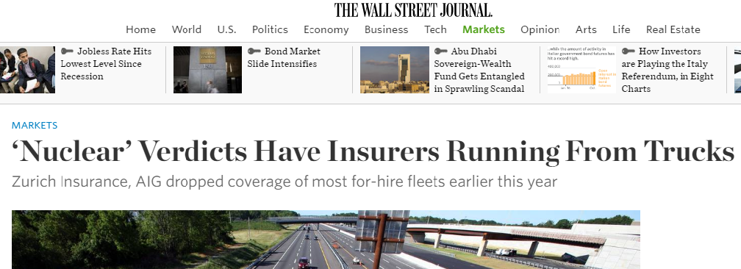
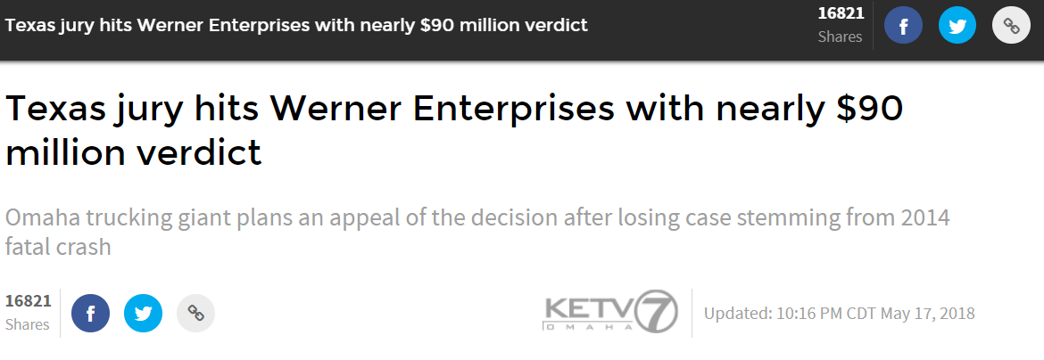
Insurance Isn’t a Sure Thing
Sources: KETV7, Wall Street Journal

Slide 27




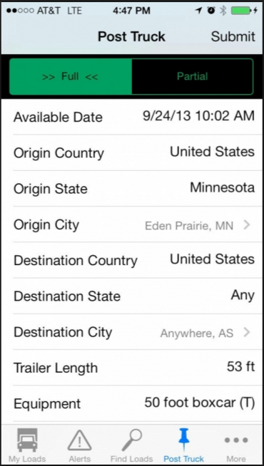
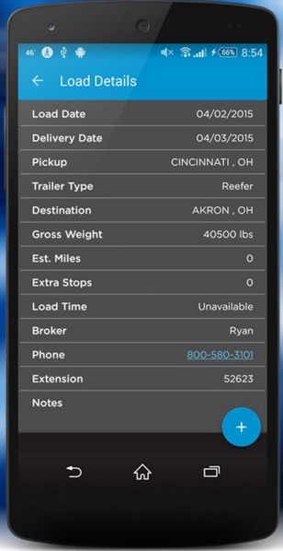
What About Uber and Maximum Overdrive (or Autonomous Trucks)?
Source: Apple, company sites

Slide 28
Capacity Summary
Truck capacity remains below peak, but has increased recently
The driver market is tight; will wage increases help?
ELDs are having an impact, so is insurance
Train speeds remain below 4Q13 levels, but are improving
Technology isn’t necessarily creating “new capacity”
Incremental supply unlikely near term

Slide 29
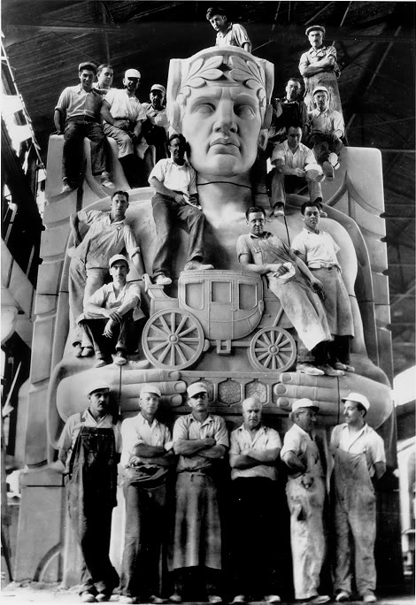
Putting It Together
Source: Google Images

Slide 30
Capacity Has Evaporated
Sources: Internet Truckstop, KeyBanc Capital Markets Inc.

Slide 31
Resulting in Elevated Spot Rates
Sources: Internet Truckstop, KeyBanc Capital Markets Inc.

Slide 32
Which Is Forcing Contract Pricing Higher
Sources: Internet Truckstop, Truckloadrate.com, KeyBanc Capital Markets Inc.

Slide 33
Rate Increases Are the Strongest in 10 Years
Sources: Truckloadrate.com, KeyBanc Capital Markets Inc.

Slide 34
While Increases Have Been Below Cost Inflation for Two Years
Sources: KeyBanc Capital Markets Inc.

Slide 35
Contract Rate Expectations Have Migrated Higher, with Weighted Average Now Indicating a LDD Increase
Sources: Internet Truckstop, Truckloadrate.com

Slide 36
Recent Elevated Orders Could Lead to Production and Incremental Supply
Sources: A.C.T. Research Co., LLC; KeyBanc Capital Markets Inc.

Slide 37
Remember When?
“…the truckload industry continues to be plagued with excess carrier capacity for the current demand environment prolonging the competitive pricing situation… This challenging pricing environment… served as headwinds to our quarterly results.” – Swift Transportation Company, April 24, 2017
“The freight environment was weak in both January and February, particularly in California, but began to improve in March…” – Knight Transportation, Inc. April 26, 2017
“Freight demand in our One-Way Truckload fleet was seasonally softer in January with weaker trends from late January 2017 to late February 2017.” – Werner Enterprises, Inc. April 20, 2017
“Freight demand was moderate during the quarter, and our industry continued to have excess capacity available in advance of the scheduled implementation and enforcement of the electronic logging mandate in December 2017. Many shippers engaged in bid processes as a means to lower upward pressure on their freight rates before any meaningful tightening of capacity.” – Covenant Transportation Group, April 20, 2017

Slide 38
Remember When? (Part II)
“Our performance in the 4Q of 2005 reflects a strong freight environment… We anticipate that driver and owner operator availability will remain constrained in 2006 and we are geared up to address this challenge.” – Swift Transportation Company, January 23, 2006
“We are very pleased to establish a new quarterly record for earnings per share. The record earnings were driven by strong truckload freight demand comparable to what we experienced in the 4Q of 2004, improved truckload pricing, decreasing fuel prices…” U.S. Xpress Enterprises, Inc. January 26, 2006
“Werner believes that a solid freight shipping market for the Company's reliable truck service offerings combined with an extremely tight truck capacity market, created the strong 4Q 2005 freight market.” – Werner Enterprises, Inc. January 23, 2006

Slide 39
Summary
Key freight end markets (industrial, oil & gas, automotive, consumer) all in concert for the first time in over a decade
How much has inventory restocking and hurricane rebuilding contributed to the current cycle?
The full impact of tax cuts may not be realized; trade uncertainty won’t help
No drivers = no capacity
Wage increases, truck builds all point to incremental supply
Startups aren’t a form of capacity
Fundamentals are favorable, but it is a cyclical market; end market demand is key; supply secondary
Agree, disagree, questions: tfowler@key.com; 216.689.0219

Slide 40
Disclosure Appendix
Important disclosures for the companies mentioned in this report can be found at https://key2.bluematrix.com/sellside/Disclosures.action
Reg A/C Certification
The research analyst(s) responsible for the preparation of this research report certifies that:(1) all the views expressed in this research report accurately reflect the research analyst's personal views about any and all of the subject securities or issuers; and (2) no part of the research analyst's compensation was, is, or will be directly or indirectly related to the specific recommendations or views expressed by the research analyst(s) in this research report.
Other Disclosures
KeyBanc Capital Markets is a trade name under which corporate and investment banking products and services of KeyCorp and its subsidiaries, KeyBanc Capital Markets Inc., Member NYSE/FINRA/SIPC (“KBCMI”), and KeyBank National Association (“KeyBank N.A.”), are marketed. Pacific Crest Securities is a division of KeyBanc Capital Markets Inc.
KeyBanc Capital Markets Inc. (“KBCMI”) does and seeks to do business with companies covered in its research reports. As a result, investors should be aware that the firm may have a conflict of interest that could affect the objectivity of this report. Investors should consider this report as only a single factor in making their investment decision.
This report has been prepared by KBCMI. The material contained herein is based on data from sources considered to be reliable; however, KBCMI does not guarantee or warrant the accuracy or completeness of the information. It is published for informational purposes only and should not be used as the primary basis of investment decisions. Neither the information nor any opinion expressed constitutes an offer, or the solicitation of an offer, to buy or sell any security. The opinions and estimates expressed reflect the current judgment of KBCMI and are subject to change without notice. This report may contain forward-looking statements, which involve risk and uncertainty. Actual results may differ significantly from the forward-looking statements. This report is not intended to provide personal investment advice and it does not take into account the specific investment objectives, financial situation and the specific needs of any person or entity.
No portion of an analyst’s compensation is based on a specific banking transaction; however, part of his/her compensation may be based upon overall firm revenue and profitability, of which investment banking is a component. Individuals associated with KBCMI (other than the research analyst(s) listed on page 1 of this research report) may have a position (long or short) in the securities covered in this research report and may make purchases and/or sales of those securities in the open market or otherwise without notice. As required by FINRA Rule 2241(C)(4)(A), financial interest, if any, by any research analysts listed on page 1 of this report will be disclosed in Important Disclosures, Company-specific regulatory disclosures located above in the Disclosure Appendix. KBCMI itself may have a position (long or short) in the securities covered in this research report and may make purchases and/or sales of those securities in the open market or otherwise without notice. As required by FINRA Rule 2241(C)(4)(F), if KBCMI, or its affiliates, beneficially own 1% or more of any class of common equity securities in the subject company(ies) in this research report, it will be disclosed in Important Disclosures, Company-specific regulatory disclosures located above in the Disclosures Appendix. This communication is intended solely for use by KBCMI clients. The recipient agrees not to forward or copy the information to any other person without the express written consent of KBCMI.
Investors should assume that we are seeking or will seek investment banking or other business relationships with the company described in this report.
Rating System:
Overweight (OW) – We expect the stock to outperform the analyst's coverage sector over the coming 6-12 months.
Sector Weight (SW) – We expect the stock to perform in line with the analyst's coverage sector over the coming 6-12 months.
Underweight (UW) – We expect the stock to underperform the analyst's coverage sector over the coming 6-12 months.

